Slide 1
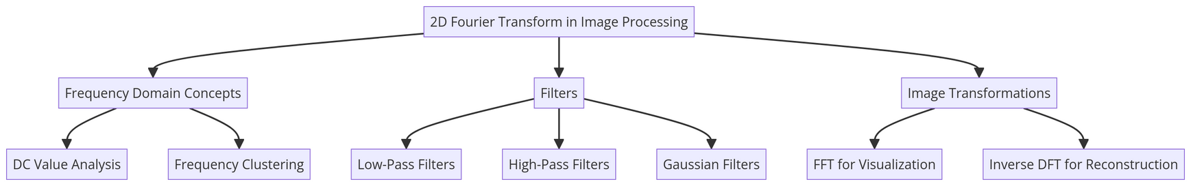
DIGITAL IMAGE PROCESSING
IMAGE SMOOTHENING AND SHARPENING USING FREQUENCY DOMAIN FILTERING TECHNIQUE;
sampling and aliasing
BY:FAISAL HAKIMI

Slide 2
INTRODUCTION
This Presentation Explains 2D Discrete Fourier transformation and frequency domain filtering in image processing, with a deep focus on the application of Fourier transforms. The process involves transforming an image into the frequency domain, applying specific filters, and then performing an inverse transformation to produce the output image. Various filters, including ideal, Gaussian, and Laplace filters, are introduced and analyzed for their effects on image quality. Additionally, the report discusses sampling and aliasing, emphasizing the necessity of sampling at least twice the Nyquist frequency to prevent spatial aliasing. Real-world examples, such as anti-aliasing and moiré patterns in video games, are provided to illustrate these concepts.

Slide 3
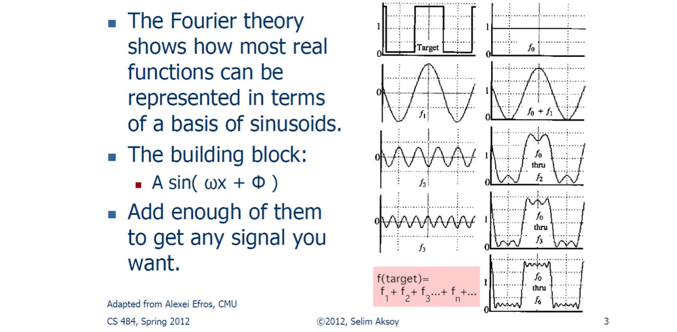
FOURIER TRANSFORM
Fourier Transform is the part of integral transform; Jean Baptiste Fourier introduced this method due to his interest in understanding the distribution and conduction of heat across different materials. He says any single-variable function can be expressed as a weighted combination of sine and cosine functions with varying frequencies. This method is commonly used to convert time-domain signals into the frequency domain. Fourier

Slide 4
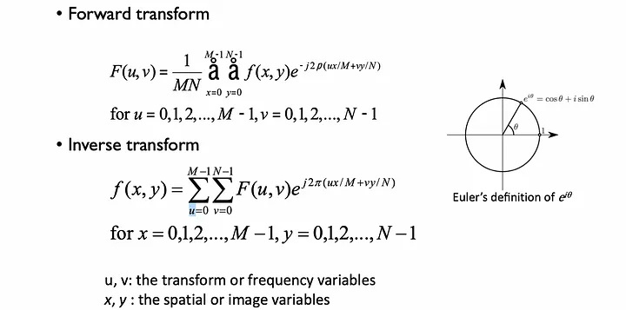
2D DISCRETE FOURIER TRANSFORM
Images are stored as discrete pixel values, so we cannot use the continuous Fourier Transform directly for digital images. The Discrete Fourier Transform (DFT) calculates the Fourier Transform for discrete data points, make it suitable for digital images. Where 2D DFT is an extension of the 1D DFT, particularly used to analyze 2D signals like digital images. It converts spatial domain into the frequency domain, help in understanding the frequency components present in the image.

Slide 5
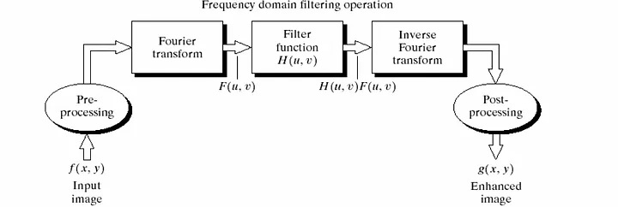
FREQUENCY DOMAIN FILTERING
The use of frequency domain technique for an image enhancement, procedures required are:
Transform the input image into the Fourier domain.
Multiplying the FT image by a filter.
Take the inverse FT of the image to get the resulting enhanced image.

Slide 6
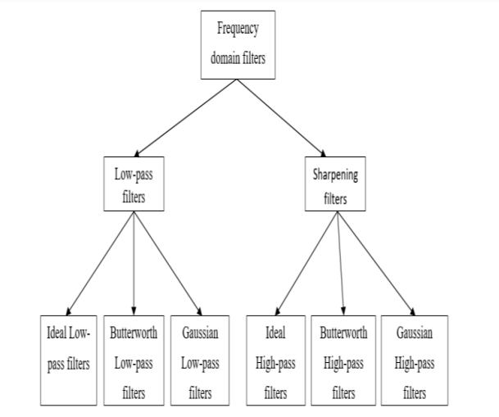
IDEAL FILTERS
Ideal filters are a type of frequency domain filter used to process images by selectively preserving or suppressing specific frequency components. They are often categorized into low-pass, high-pass, band-pass, and band-stop filters. These filters are characterized by their sharp transition between the passband and stopband, creating an abrupt cutoff in the frequency spectrum.

Slide 7
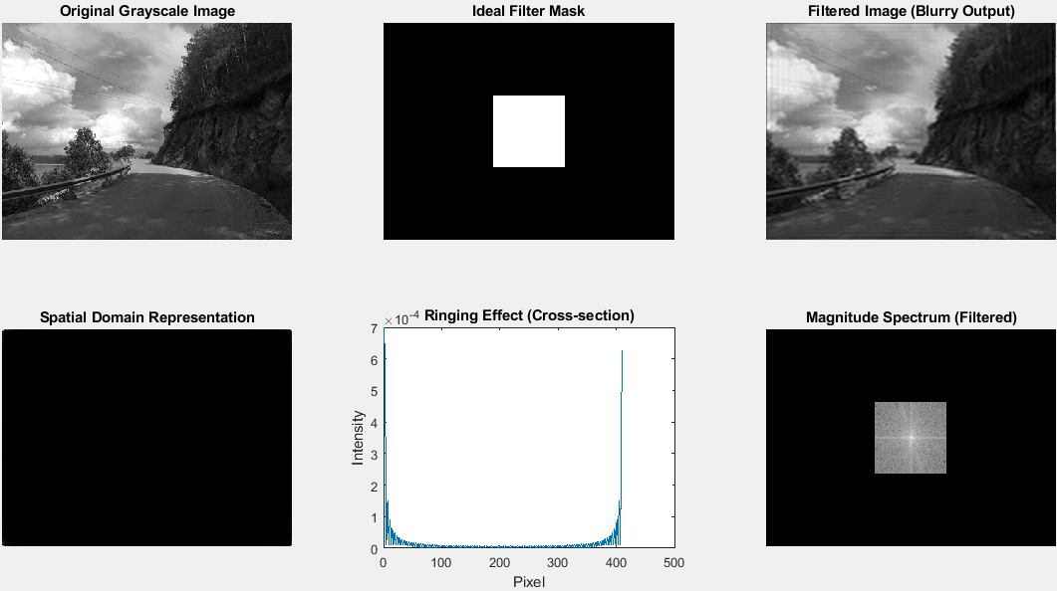

Slide 8
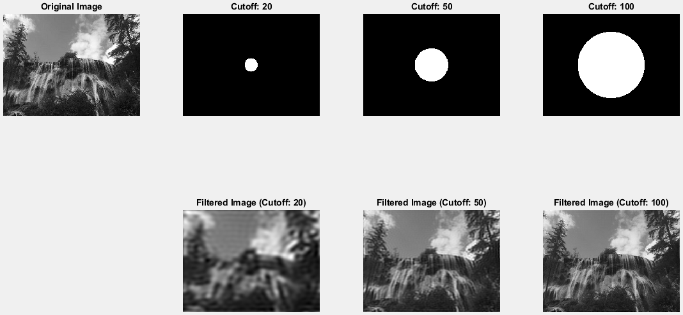
RINGING ARTIFACTS
Ringing artifacts are unwanted oscillations that appear near edges or sharp transitions in an image. They are a common byproduct of using frequency domain filters, especially those with sharp cutoffs like Ideal Filters.

Slide 9
SAMPLING AND ALIASING IN IMAGE PROCESSING
Sampling
Sampling is the process of converting a continuous image into a discrete form by measuring its intensity values at specific intervals (pixels). It is a fundamental step in digital image processing.
Aliasing:
Aliasing occurs when the image is undersampled, causing high-frequency components to appear as lower frequencies.
This results in visual distortions, such as moiré patterns or jagged edges.
Causes of Aliasing
Undersampling: Sampling at intervals larger than required for the given image frequency.
Improper Filtering: Failure to apply a low-pass (anti-aliasing) filter before sampling to remove high frequencies.

Slide 10
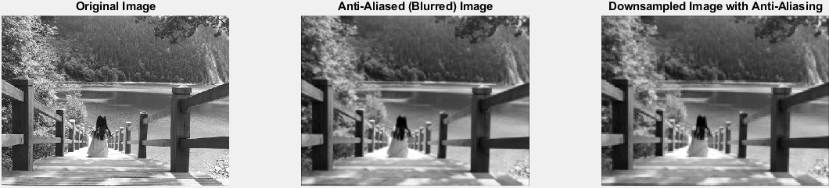
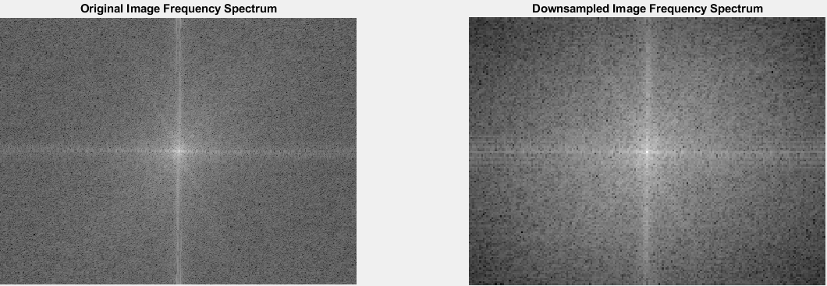

Slide 11
CONCLUSION
This reportcovered key concepts in image processing, focusing on sampling, anti-aliasing,
downsampling, and artifact reduction. We learned that applying low-pass filters, like Gaussian
filters, before downsampling helps reduce visual artifacts such as aliasing by smoothing high-
frequency components. Anti-aliasing prevents jagged edges and is widely used in applications like
video games to improve image quality.
We also explored how sampling frequency affects image clarity and how Moire patterns emerge
when two grids overlap at different angles due to insufficient sampling. By applying appropriate filters
and downsampling techniques, we can enhance image quality and minimize common artifacts like
blurring, ringing, and Moire patterns, leading to clearer and more accurate images.

Slide 12
Thank you

